Slide 1
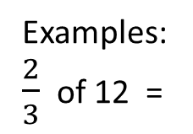
24
7
30
Date
Fraction of a quantity
EQ – How do I find a fraction of a quantity?
When finding a fraction of a quantity (amount), the key rule to remember is to divide the quantity by the denominator and multiply your answer by the numerator.
Fraction of a quantity:
Divide the quantity by denominator
Multiply answer by numerator
Examples:
$\frac{2}{3}$ of 12 =
12 ÷ 3
× 2
= 4 × 2
= 8

Slide 2

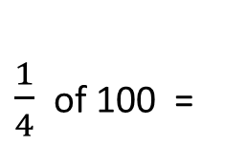
24
7
30
Date
Fraction of a quantity
EQ – How do I find a fraction of a quantity?
How much is one-quarters of a metre?
one-quarter is $\frac{1}{4}$
One metre is 100 cm
$\frac{1}{4}$ of 100 =
100 ÷ 4
× 1
= 25 × 1
= 25cm

Slide 3
Exercises
Exercise 1.3 from Dwyer
All to be done with a smile on your faces.

Slide 4
Notes Review
24, 7 ,30
Date
Title
Essential question
Notes complete
Notes complete with colour and diagrams
Questions completed
Contents page filed in
Formula page filled in

Slide 5
Homework
Review your notes and write a summary answering the essential question.

